Slide 1
ForceMoCap (FMC) System
Introduction and Evaluation

Slide 2
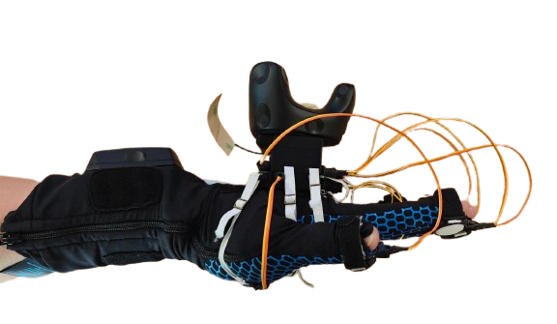
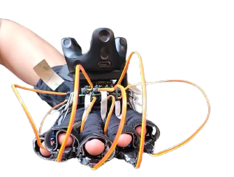
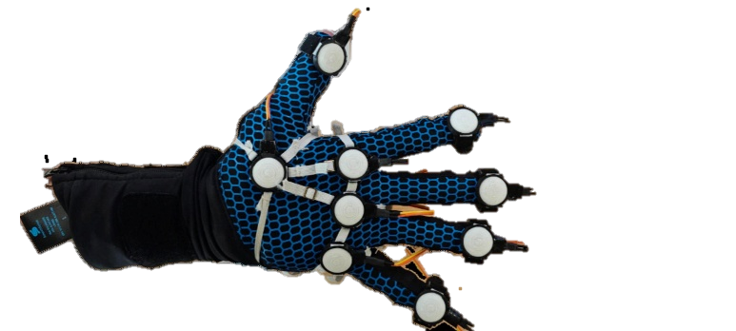
ForceMoCap (FMC) Gloves
Finger Force Sensor
StretchSense Glove
Vive Motion Capture Marker
Insulated Circuit Board
Palm Force Sensor
Side View
Front View
Bottom View

Slide 3
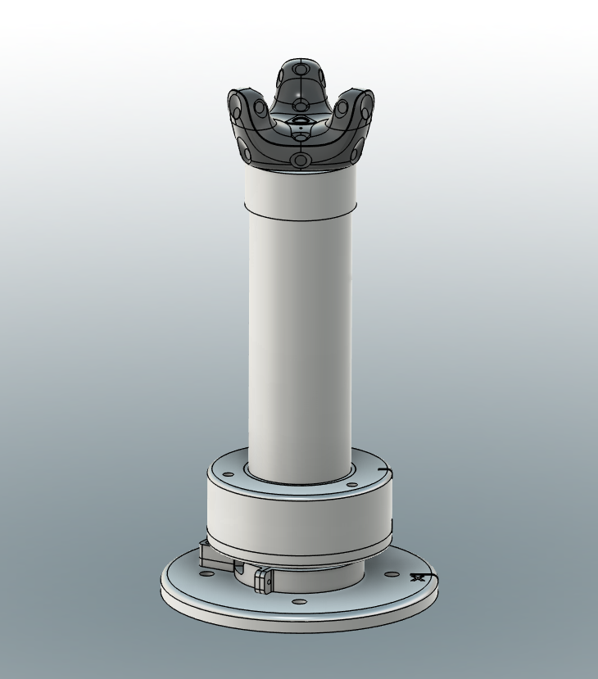
Study 1: Single 6-DOF joint

Slide 4
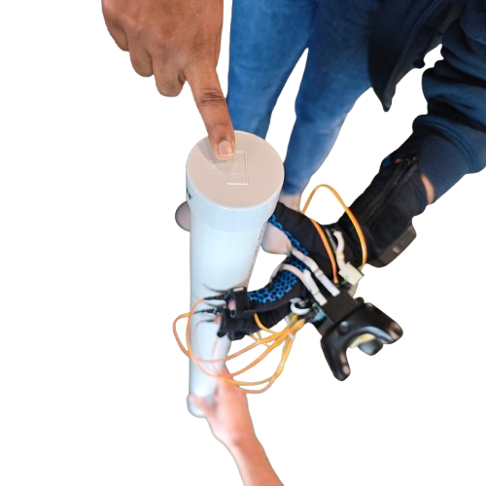
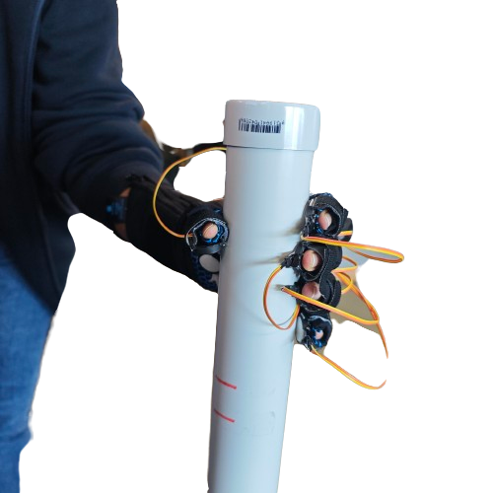
Overall Protocol
Physical Human-Environment Interaction is measured and evaluated in two sub-experiments
Exp 1a: Normal Force Dynamics (6 Exercises)
Exp 1b: Grasp Dynamics (10 Exercises)

Slide 5
Overall Protocol
For each exercise
Participants will apply and maintain 1 level of force / moment for 7 seconds each with a 3-second rest interval.
Participants will repeat this level of force for 3 repetitions
Each exercise will have 4 levels of wrenches
Force Magnitude: 5N, 10N, 15N, 20N
Moment Magnitude: 0.5Nm, 1.0Nm, 1.5Nm, 2.0Nm
Visual feedback will be given to regulate applied wrenches
Maintain
5 seconds
Rest
3 seconds
Rest
3 seconds
Apply Lvl N Wrench
2 seconds
Maintain
5 seconds
Rest
3 seconds
Apply Lvl N Wrench
2 seconds
Maintain
5 seconds
Apply Lvl N Wrench
2 seconds
Level N completed

Slide 6
Exp 1a: Normal Force Dynamics
Type 1: Fingers Force
Finger Force Sensor

Slide 7
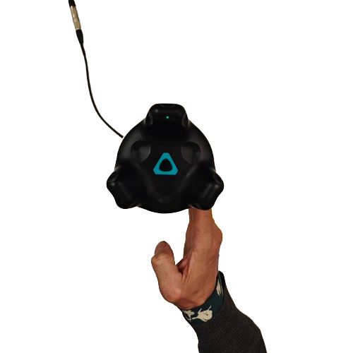
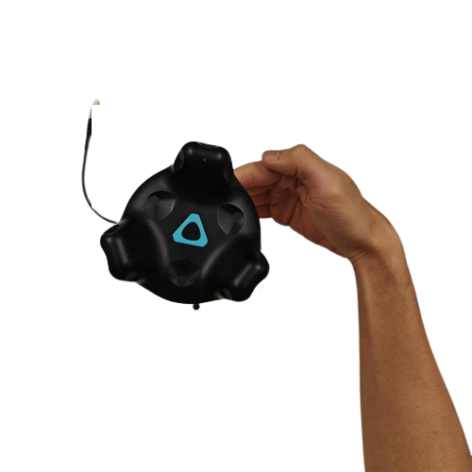
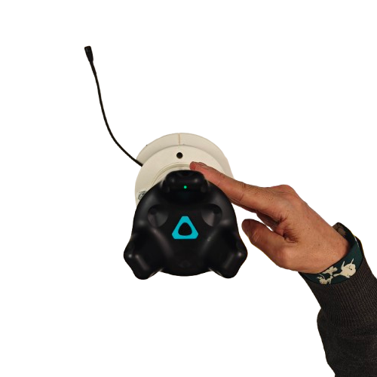

Exp 1a: Normal Force Dynamics
Y
$$F_{applied}$$
Type 1: Fingers Force
X
Face
Face
Face
X-force LH: +ve
RH: -ve
Y-force LH: -ve
RH: -ve
XY-force LH: +ve X –ve Y
RH:-ve X –ve Y

Slide 8
Exp 1a: Normal Force Dynamics
Type 2: Palm Force
Palm Force Sensor

Slide 9
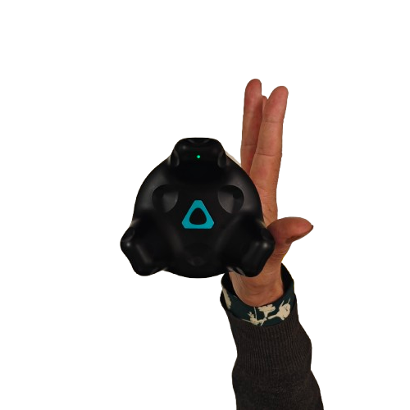
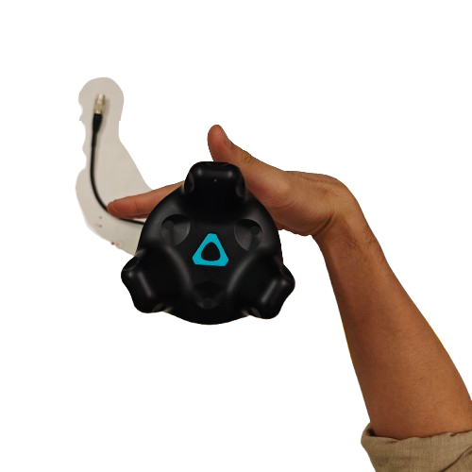
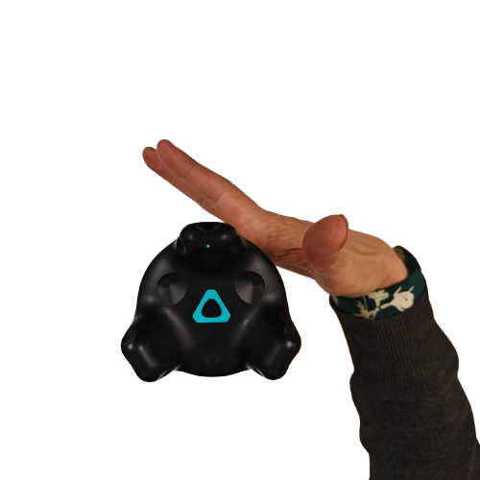

Exp 1a: Normal Force Dynamics
Y
$$F_{applied}$$
Type 2: Palm Force
X
Face
Face
Face
X-force LH: +ve
RH: -ve
Y-force LH: -ve
RH: -ve
XY-force LH: +ve X –ve Y
RH:-ve X –ve Y

Slide 10
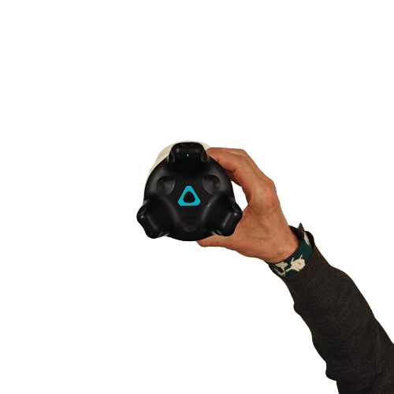
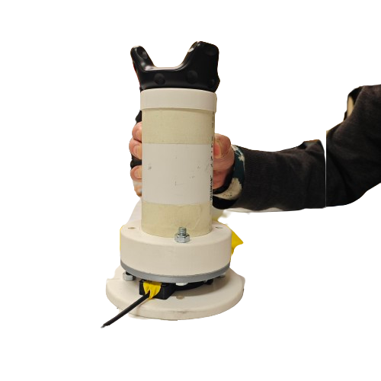
Exp 1b: Grasp Dynamics
Type 1: Finger Grasp

Slide 11


Exp 1b: Grasp Dynamics
Y
Z
$$F_{applied}$$
Type 1: Finger Grasp
$$F_{applied}$$
X
Y
Face
Face
Massage
Z axis push

Slide 12


Exp 1b: Grasp Dynamics
Y
Z
Type 1: Finger Grasp
$$τ_{applied}$$
X
Y
$$τ_{applied}$$
Face
Face
Face
X-axis twist
LH : +ve RH: +ve
Y-axis twist
LH : +ve RH: -ve
Z-axis twist
LH : -ve RH: +ve

Slide 13
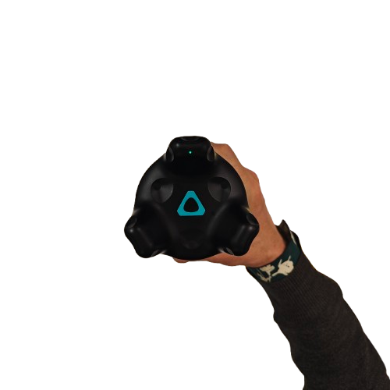
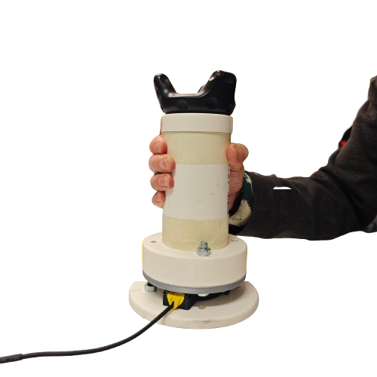
Exp 1b: Grasp Dynamics
Type 2: Power Grasp

Slide 14
Exp 1b: Grasp Dynamics
Y
Z
Direction of force
Type 1: Power Grasp
Direction of force
X
Y
Face
Face
Massage
Z axis lift / push

Slide 15
Exp 1b: Grasp Dynamics
Y
Z
Type 1: Power Grasp
$$τ_{applied}$$
X
Y
$$τ_{applied}$$
Face
Face
Face
X-axis twist
LH : +ve RH: +ve
Y-axis twist
LH : +ve RH: -ve
Z-axis twist
LH : -ve RH: +ve

